Slide 1
Linear Regression Deploy Score Code

Slide 2
Simple Example

Slide 3
MODEL DEPLOYMENT: Simple Example
This example is taken from the previously mentioned Draper and Smith reference.
The data describes monthly steam usage in a manufacturing plant
Y Monthly use of steam
X6 Operating days per month
X8 Average temperature in degrees Fahrenheit
NOTE: Draper and Smith named their variables X6 and X8, don’t worry about that. The names of the variables are not important and don’t affect the formula.
Raw Data is given on the following slide.
SAS Code is provided to read data into SAS

Slide 4
MODEL DEPLOYMENT: Simple Example
Raw Steam Usage Data
 | X6 | X8 | Y
1 | 20 | 35.3 | 10.98
2 | 20 | 29.7 | 11.13
3 | 23 | 30.8 | 12.51
4 | 20 | 58.8 | 8.4
5 | 21 | 61.4 | 9.27
6 | 22 | 71.3 | 8.73
7 | 11 | 74.4 | 6.36
8 | 23 | 76.7 | 8.5
9 | 21 | 70.7 | 7.82
10 | 20 | 57.5 | 9.14
11 | 20 | 46.4 | 8.24
12 | 21 | 28.9 | 12.19
13 | 21 | 28.1 | 11.88
14 | 19 | 39.1 | 9.57
15 | 23 | 46.8 | 10.94
16 | 20 | 48.5 | 9.58
17 | 22 | 59.3 | 10.09
18 | 22 | 70 | 8.11
19 | 11 | 70 | 6.83
20 | 23 | 74.5 | 8.88
21 | 20 | 72.1 | 7.68
22 | 21 | 58.1 | 8.47
23 | 20 | 44.6 | 8.86
24 | 20 | 33.4 | 10.36
25 | 22 | 28.6 | 11.08

Slide 5
MODEL DEPLOYMENT: Simple Example
SAS Data Step to read in raw data
data TEMPFILE;
input X6 X8 Y;
datalines;
20 35.3 10.98
20 29.7 11.13
23 30.8 12.51
20 58.8 8.40
21 61.4 9.27
22 71.3 8.73
11 74.4 6.36
23 76.7 8.50
21 70.7 7.82
20 57.5 9.14
20 46.4 8.24
21 28.9 12.19
21 28.1 11.88
19 39.1 9.57
23 46.8 10.94
20 48.5 9.58
22 59.3 10.09
22 70.0 8.11
11 70.0 6.83
23 74.5 8.88
20 72.1 7.68
21 58.1 8.47
20 44.6 8.86
20 33.4 10.36
22 28.6 11.08
;
run;

Slide 6
MODEL DEPLOYMENT: Simple Example
SAS has many procs that can do Linear Regression. Here in one of them:
proc reg data=TEMPFILE;
model Y = X6 X8;
run;
quit;

Slide 7
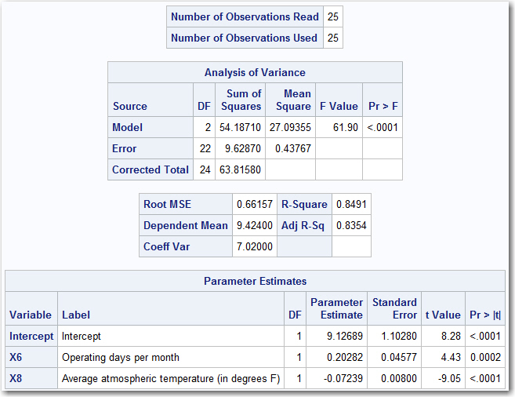
MODEL DEPLOYMENT: Simple Example
Here are the results from PROC REG

Slide 8
MODEL DEPLOYMENT: Simple Example
Here are the results from PROC REG
Beta Values

Slide 9
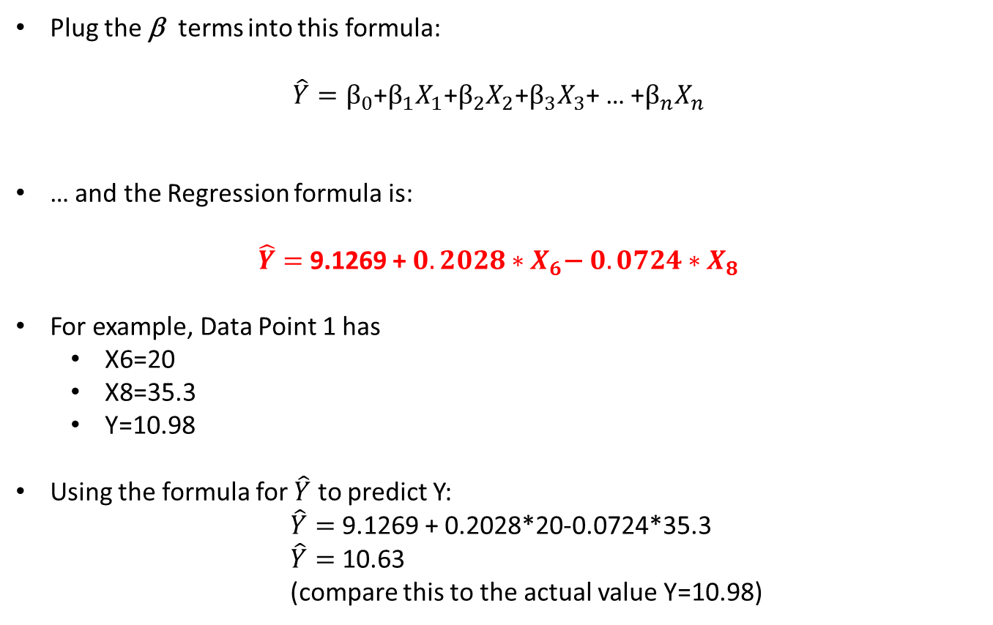
MODEL DEPLOYMENT: Simple Example
Plug the β terms into this formula:
$\hat{Y}=β_{0}$+$β_{1}X_{1}\text{+}β_{2}X_{2}$+$β_{3}X_{3}$+ … +$β_{n}X_{n}$
… and the Regression formula is:
$\hat{Y}=$ 9.1269 +${ 0.2028∗X}_{6}\text{−} 0.0724∗X_{8}$
For example, Data Point 1 has
X6=20
X8=35.3
Y=10.98
Using the formula for $\hat{Y}$ to predict Y:
$\hat{Y}=$ 9.1269 + 0.2028*20-0.0724*35.3
$\hat{Y}=$ 10.63
(compare this to the actual value Y=10.98)

Slide 10
MODEL DEPLOYMENT: Simple Example
A SAS Data Step can score new data using the results from the Regression. Here is what the Data Step might look like.
data NEWFILE;
set TEMPFILE;
Y_Hat = 9.12689 + 0.20282*X6 - 0.07239*X8;
run;
To use this Data Step, simply replace “TEMPFILE” with the name of your file. The results will be stored in a data set called “NEWFILE”.
This is simple enough, but to make this more general purpose, it would be easy to put this Data Step inside of a SAS Macro.

Slide 11
MODEL DEPLOYMENT: Simple Example
The Data Step is now contained in a SAS Macro:
%macro SCORE( INFILE, OUTFILE );
data &OUTFILE.;
set &INFILE.;
Y_Hat = 9.12689 + 0.20282*X6 - 0.07239*X8;
run;
%mend;
When you call the SAS Macro, pass it the name of the data set and a name of a new data set where you want to store the results.
%SCORE( TEMPFILE, MY_NEW_FILE );

Slide 12
MODEL DEPLOYMENT: Simple Example
The output of the proc print would be:
 | X6 | X8 | Y | Y_Hat
1 | 20 | 35.3 | 10.98 | 10.63
2 | 20 | 29.7 | 11.13 | 11.03
3 | 23 | 30.8 | 12.51 | 11.56
4 | 20 | 58.8 | 8.4 | 8.93
5 | 21 | 61.4 | 9.27 | 8.94
6 | 22 | 71.3 | 8.73 | 8.43
7 | 11 | 74.4 | 6.36 | 5.97
8 | 23 | 76.7 | 8.5 | 8.24
9 | 21 | 70.7 | 7.82 | 8.27
10 | 20 | 57.5 | 9.14 | 9.02
11 | 20 | 46.4 | 8.24 | 9.82
12 | 21 | 28.9 | 12.19 | 11.29
13 | 21 | 28.1 | 11.88 | 11.35
14 | 19 | 39.1 | 9.57 | 10.15
15 | 23 | 46.8 | 10.94 | 10.40
16 | 20 | 48.5 | 9.58 | 9.67
17 | 22 | 59.3 | 10.09 | 9.30
18 | 22 | 70 | 8.11 | 8.52
19 | 11 | 70 | 6.83 | 6.29
20 | 23 | 74.5 | 8.88 | 8.40
21 | 20 | 72.1 | 7.68 | 7.96
22 | 21 | 58.1 | 8.47 | 9.18
23 | 20 | 44.6 | 8.86 | 9.95
24 | 20 | 33.4 | 10.36 | 10.76
25 | 22 | 28.6 | 11.08 | 11.52

Slide 13
MODEL DEPLOYMENT: Simple Example
Now it is possible to predict the “Y” value for new input values. For example:
data SomeNewData;
input X6 X8;
datalines;
15 25
20 35
25 45
30 50
35 55
;
run;
%SCORE(SomeNewData, NowItsScored );
proc print data=NowItsScored;
run;

Slide 14
MODEL DEPLOYMENT: Simple Example
The output of the proc print would be:
 | X6 | X8 | Y_Hat
1 | 15 | 25 | 10.36
2 | 20 | 35 | 10.65
3 | 25 | 45 | 10.94
4 | 30 | 50 | 11.59
5 | 35 | 55 | 12.24

Slide 15
Other Considerations Missing Values

Slide 16
MISSING VALUES:
Any code that handled missing values before the call to PROC REG must be implemented into the score code.
Example:
Assume four input variables A, B, C, D are used to predict Y
Assume that some of the values of A, B, C, and D were missing and a company used the following business rules to impute (“fix”) the records:
If “A” is missing then delete the record
If “B” is missing then assign a value of 10
If “C” is missing, then assign 5 or 15 depending on if A > 0 or A <= 0
If “D” is missing, then assign 25, and set a flag variable to missing.

Slide 17
MISSING VALUES:
Here is the data step code that will follow these rules:
data INFILE2;
Set INFILE1;
if missing(A) then delete;
if missing(B) then B = 10;
if missing(C) then do;
if A>0 then C=5; else C=10;
end;
D_Missing_Flag = 0;
if missing(D) then do;
D_Missing_Flag = 1;
D = 25;
end;
run;

Slide 18
MISSING VALUES:
Assume that the following code was run to compute the Beta Values:
Proc reg data=INFILE2;
Model Y = A B C D D_Missing_Flag;
Run;
Assume that these were the resulting coefficients
Intercept = 5
A = 4.5
B = -3.2
C = 6.1
D = -2.6
D_Missing_Flag = 13

Slide 19
MISSING VALUES:
The Data Step is now contained in a SAS Macro.
%macro SCORE( INFILE, OUTFILE );
data &OUTFILE.;
set &INFILE.;
if missing(A) then delete;
if missing(B) then B = 10;
if missing(C) then do;
if A>0 then C=5; else C=10;
end;
D_Missing_Flag = 0;
if missing(D) then do;
D_Missing_Flag = 1;
D = 25;
end;
Y_Hat = 5 + 4.5*A-3.2*B+6.1*C-2.6*D+13*D_Missing_Flag;
run;
%mend;

Slide 20
MISSING VALUES:
The Data Step is now contained in a SAS Macro. Notice the missing value code
%macro SCORE( INFILE, OUTFILE );
data &OUTFILE.;
set &INFILE.;
if missing(A) then delete;
if missing(B) then B = 10;
if missing(C) then do;
if A>0 then C=5; else C=10;
end;
D_Missing_Flag = 0;
if missing(D) then do;
D_Missing_Flag = 1;
D = 25;
end;
Y_Hat = 5 + 4.5*A-3.2*B+6.1*C-2.6*D+13*D_Missing_Flag;
run;
%mend;

Slide 21
Other Considerations Variable Transformation

Slide 22
TRANSFORM VALUES:
Any code that transforms values before the call to PROC REG must be implemented into the score code.
Example:
Assume that in the previous example, the “B” value must be transformed with a natural log (“ln”) transform. In SAS, this is represented with “log”. This code will be added to the previous missing value imputation code.

Slide 23
TRANSFORM VALUES :
Here is the data step code that will follow these rules:
data INFILE2;
Set INFILE1;
if missing(A) then delete;
if missing(B) then B = 10;
if missing(C) then do;
if A>0 then C=5; else C=10;
end;
D_Missing_Flag = 0;
if missing(D) then do;
D_Missing_Flag = 1;
D = 25;
end;
B = log(B);
run;

Slide 24
MISSING VALUES:
Assuming that nothing else changed, the new Data Step score code is presented in the SAS Macro below.
%macro SCORE( INFILE, OUTFILE );
data &OUTFILE.;
set &INFILE.;
if missing(A) then delete;
if missing(B) then B = 10;
if missing(C) then do;
if A>0 then C=5; else C=10;
end;
D_Missing_Flag = 0;
if missing(D) then do;
D_Missing_Flag = 1;
D = 25;
end;
B = log(B);
Y_Hat = 5 + 4.5*A-3.2*B+6.1*C-2.6*D+13*D_Missing_Flag;
run;
%mend;

Slide 25
MISSING VALUES:
Assuming that nothing else changed, the new Data Step score code is presented in the SAS Macro below. Notice the transform of the B variable.
%macro SCORE( INFILE, OUTFILE );
data &OUTFILE.;
set &INFILE.;
if missing(A) then delete;
if missing(B) then B = 10;
if missing(C) then do;
if A>0 then C=5; else C=10;
end;
D_Missing_Flag = 0;
if missing(D) then do;
D_Missing_Flag = 1;
D = 25;
end;
B = log(B);
Y_Hat = 5 + 4.5*A-3.2*B+6.1*C-2.6*D+13*D_Missing_Flag;
run;
%mend;

